Slide 1
ALGORITHMS / INSTRUCTIONS (알고리즘/지시)

Slide 2

WHAT IS AN ALGORITHM
Set of steps used to complete a specific task.
When you write an algorithm you need to include precise, step-by-step instructions.

Slide 3
STRUCTURE OF AN ALGORITHM
1
2
3
SEQUENCE
SELECTION
LOOPS
Actions completed in a specific order
Completing an action by making a decision or answering a question
Repeating an action again and again

Slide 4
01
SEQUENCE
A
B
C
Actions completed in a specific order
D

Slide 5
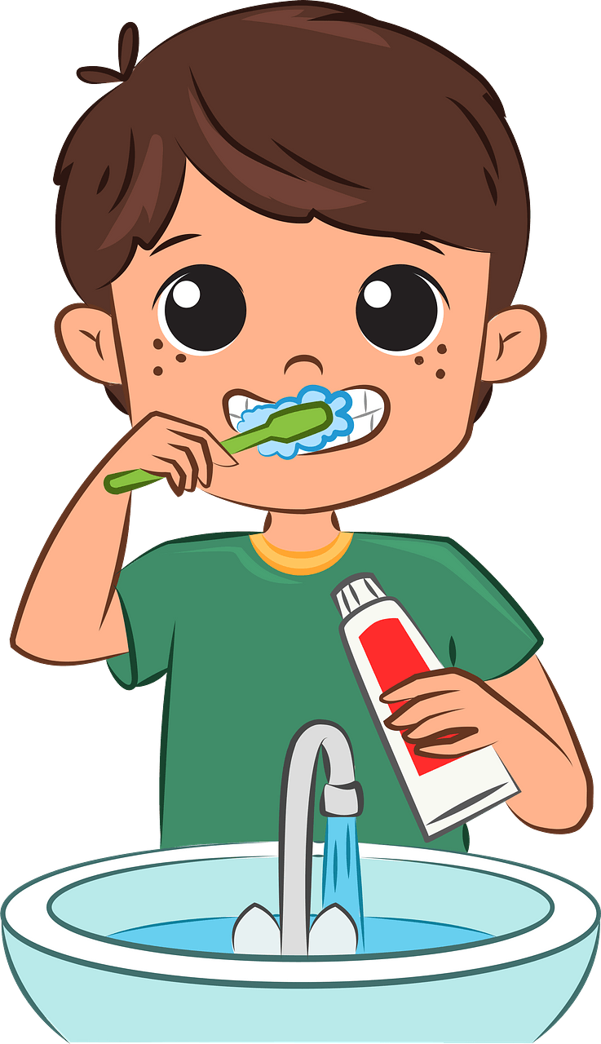
How do you brush your teeth in the morning?

Slide 6
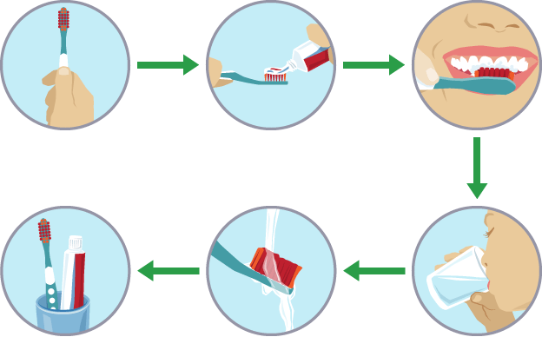
STEPS TO BRUSHING YOUR TEETH
Wet your toothbrush

Slide 7
STEPS TO BRUSHING YOUR TEETH
Add a pea sized amount of toothpaste on the toothbrush

Slide 8
STEPS TO BRUSHING YOUR TEETH
Put toothbrush in your mouth and brush your teeth in a circular motion for 3 minutes

Slide 9
STEPS TO BRUSHING YOUR TEETH
Spit out the toothpaste and rinse mouth with water properly

Slide 10

STEPS TO BRUSHING YOUR TEETH
Smile and check to see if teeth are clean!

Slide 11
02
SELECTION
A
?
Completing an action by making a decision or answering a question
B
C

Slide 12


You go to brush your teeth, and you find that you're out of toothpaste

Slide 13
Do I have any extra toothpaste?

Slide 14

"Do I have any extra toothpaste?"
Yes
No
Use the extra toothpaste
Go buy some in the shop

Slide 15
03
LOOP
D
A
C
Repeating an action again and again
B

Slide 16

Steps to eating cereal

Slide 17
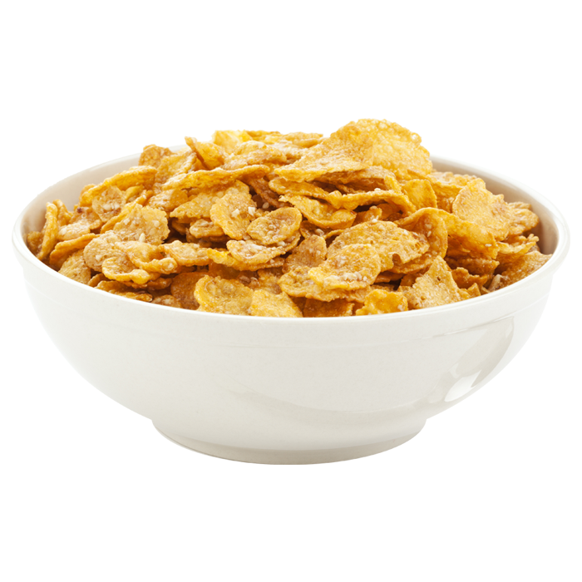
Steps to eating cereal
1: Put cereal in bowl

Slide 18
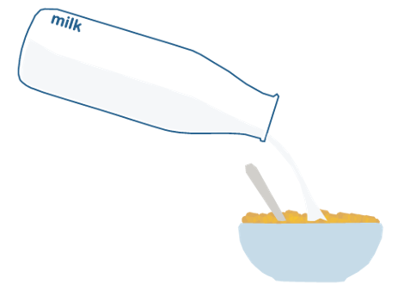

Steps to eating cereal
2: Add milk to cereal
3: Scoop the cereal and milk into mouth

Slide 19

Steps to eating cereal
2: Add milk to cereal
3: Scoop the cereal and milk into mouth
Repeat Step 3 until all cereal and milk is eaten

Slide 20
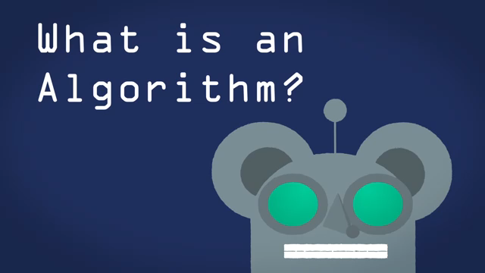

Slide 21


WHAT IS AN ALGORITHM
We use algorithms in both our normal lives and within computer science.

Slide 22

WHAT IS AN ALGORITHM
Imagine if we missed out one of the steps or reversed the order?
We could end up brushing our teeth with no toothpaste. Or not clean our teeth properly.

Slide 23
Using these 3 main structure for an algorithm, we can begin to write our instructions

Slide 24
Computers won’t understand our algorithms as they use a different language.
It will need to be translated into code

Slide 25
THANK YOU FOR WATCHING!
봐줘서 고마워!

